Slide 1
Vortex Flow Control
Optimizing Storage Efficiency
Underground Stormwater Storage and Treatment Workshop
Phillip Taylor
Stormwater Solutions Specialist
Hydro International
03/04/2014

Slide 2
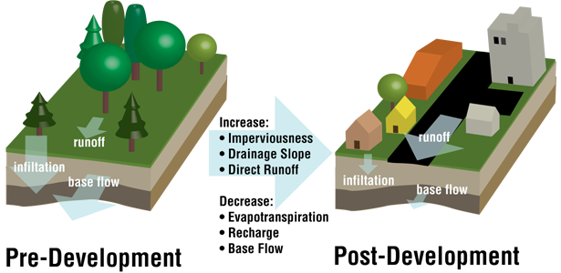
Sizing Assumption
Site size 1 ac
Pre-development C = 0.34
Post Development C = 0.99
Rational Method
1” Rainfall
60 minute duration

Slide 3
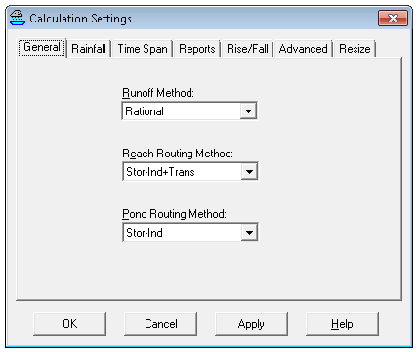
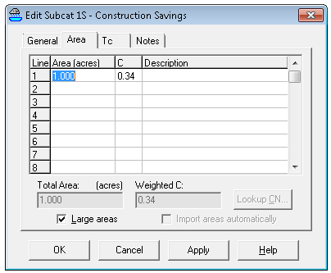
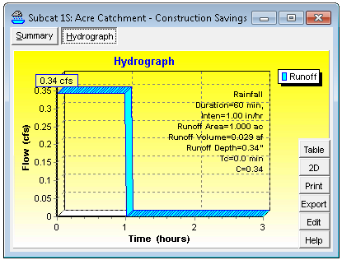
Pre-Development Condition
C = 0.34
Runoff Rate = 0.34 cfs

Slide 4
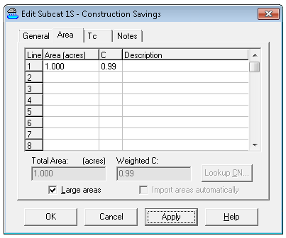
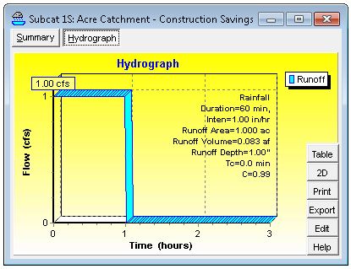
Post Development Condition
C = 0.99
Runoff Rate = 1.0 cfs

Slide 5
Outlet Control Condition
Must Attenuate 1 cfs inflow to 0.34 cfs outflow

Slide 6
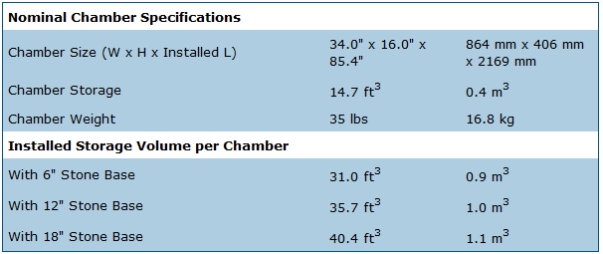
Require Underground Storage

Slide 7
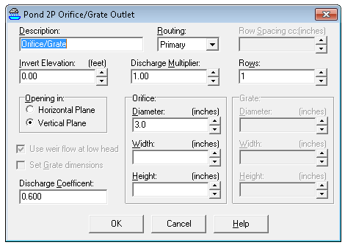
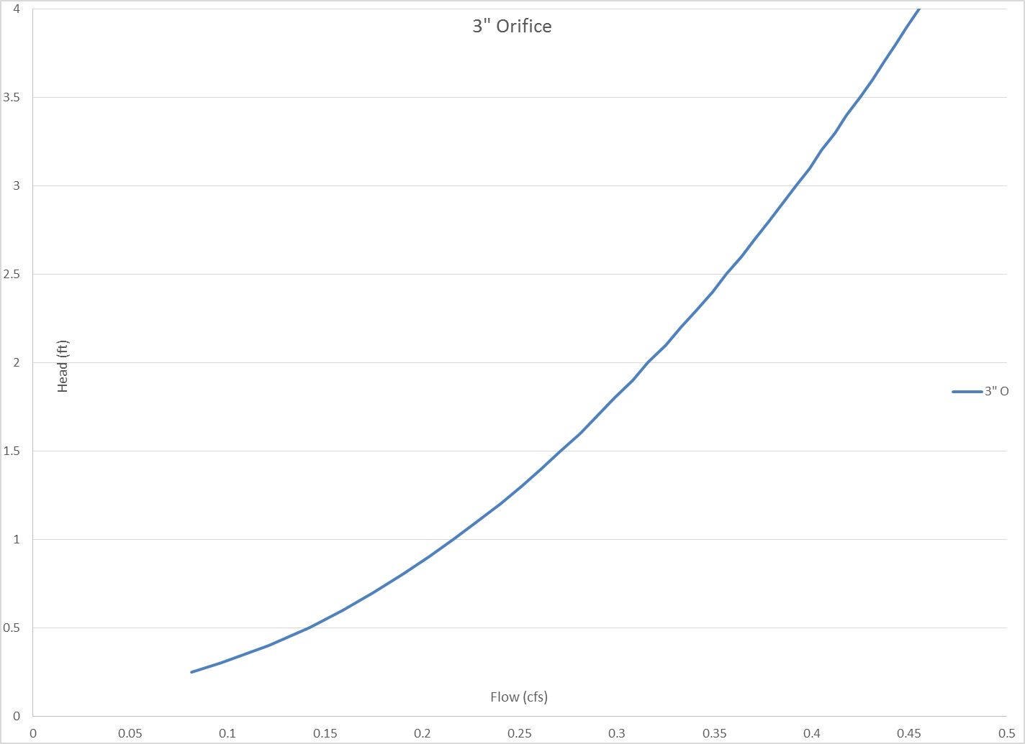
Three-inch Orifice Flow Control

Slide 8
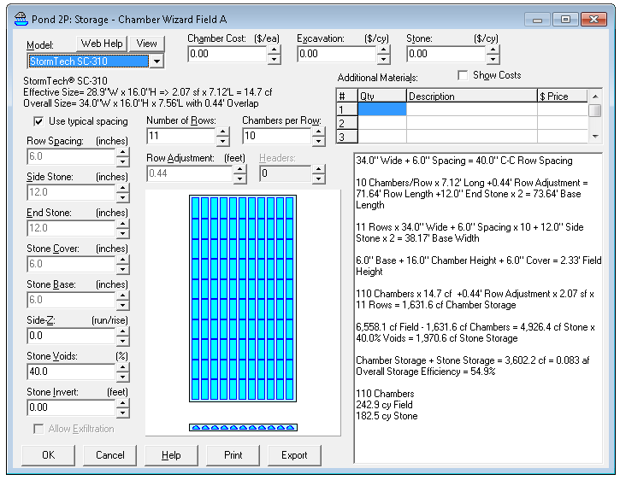
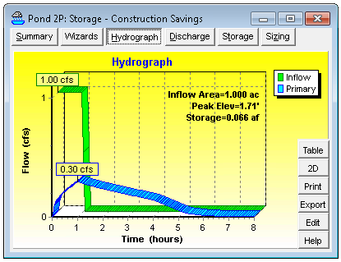
Size SC-310 Chamber Field (3” Outlet)
0.066 af / 0.084 af = 79% Efficient
Max Release Allow: 0.34 cfs

Slide 9
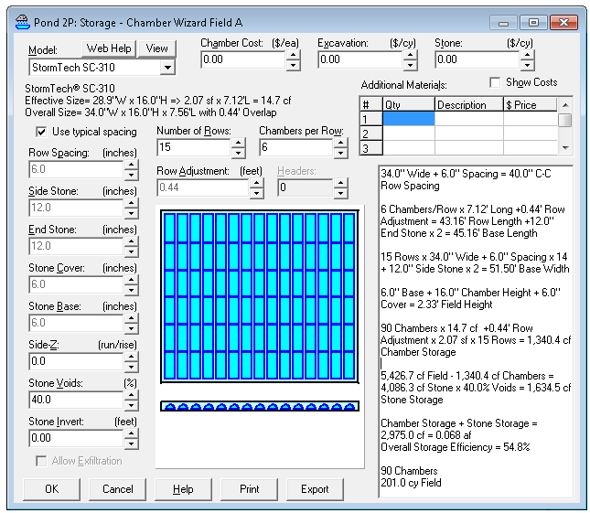
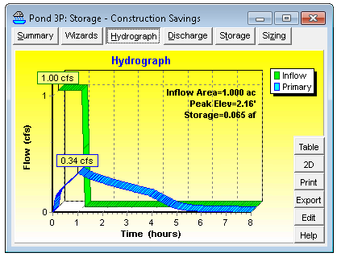
Re-size SC-310 for Efficiency (3” Outlet)
0.065 af / 0.068 af = 96% Efficient

Slide 10
Construction Summary
SC-310 Chambers sized for max efficiency
 | Quantity (Labor) | Stone (cy.) | Excavation (cy.) | Footprint (sq.ft.)
SC-310 + 3-in Orifice | 90 | 151 | 201 | 2326

Slide 11
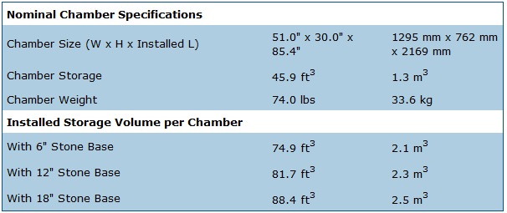
Deeper Storage SC-740 Chambers

Slide 12
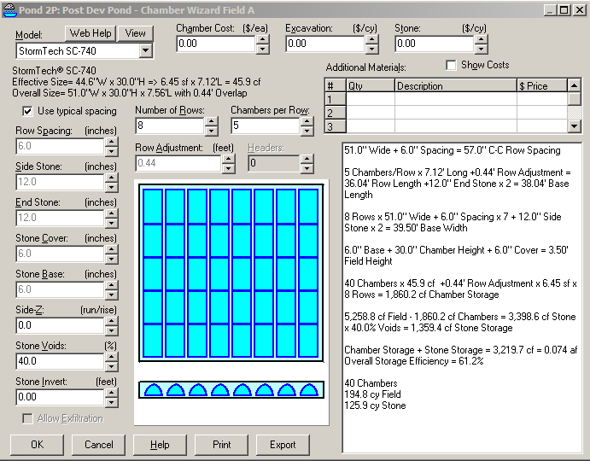
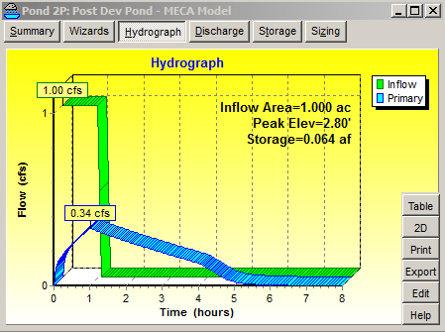
SC 740 with 2.8” Outlet
0.064 af / 0.074 af = 87% Efficient

Slide 13
Construction Savings
 | Quantity (Labor) | Stone (cy.) | Excavation (cy.) | Footprint (sq.ft.)
SC-310 + 3-in Orifice | 90 | 151 | 201 | 2326
SC-740 + 2.8-in Orifice | 40 | 126 | 195 | 1502
Savings | 55% | 17% | 3% | 35%

Slide 14
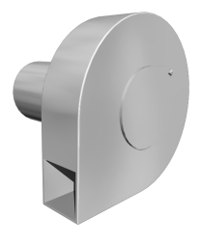
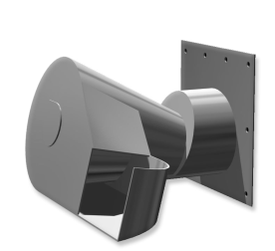
Hydro 5” Reg-U-Flo Valve
“S” Type
“C” Type
Flow control for stormwater detention
Catch basin inlet flow control
Erosion control and energy dissipation
Aeration of stormwater storage discharges
Pre-development hydrograph matching
Notes:
Purpose of Slide:
To explain the valve types.
Key Points:
“S” Type or snail shell type are used where a wet sump is wanted but can be mounted both horizontally or vertically.
“C” Type are flush invert and are used mainly in dry basin or flood control situations.
Information:

Slide 15
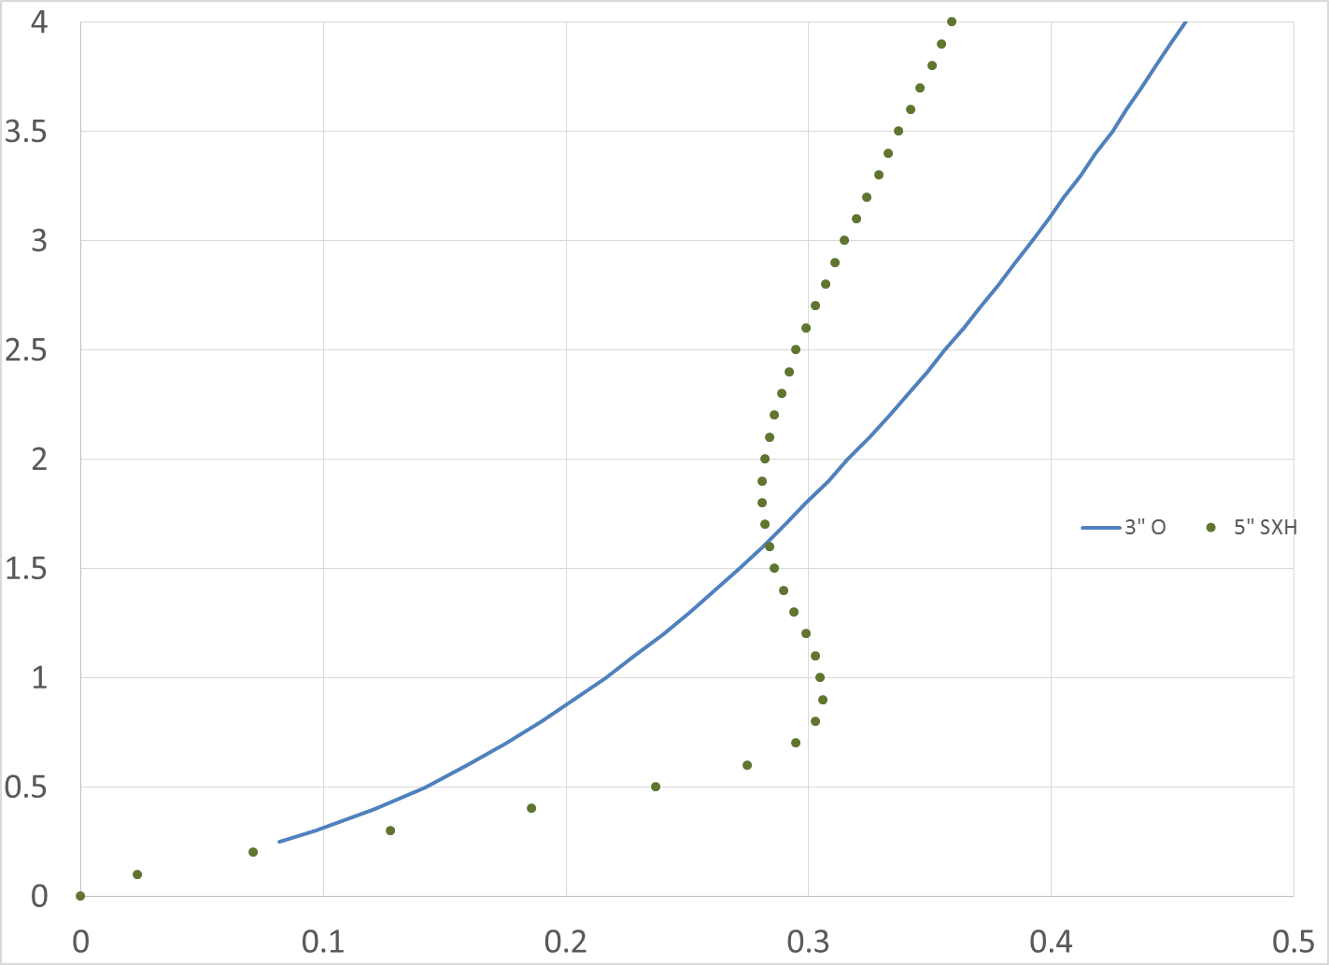
Different Discharge Curve
Head (ft)
Flow (cfs)

Slide 16
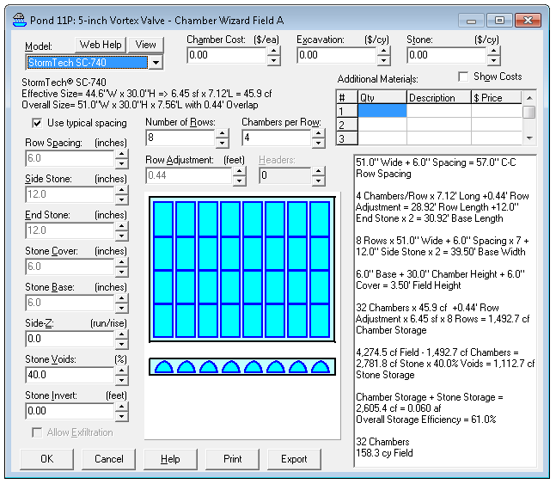
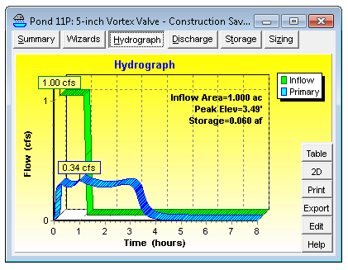
5-inch RUF Valve and SC-740
100% Efficient!

Slide 17
Construction Savings
 | Quantity (Labor) | Stone (cy.) | Excavation (cy.) | Footprint (sq.ft.)
SC-310 + 3-in Orifice | 90 | 151 | 201 | 2326
SC-740 + 2.8-in Orifice | 40 | 126 | 195 | 1502
Savings | 55% | 17% | 3% | 35%
SC-740 + 5-in Vortex | 32 | 103 | 158 | 1221
Savings | 20% | 18% | 19% | 19%

Slide 18
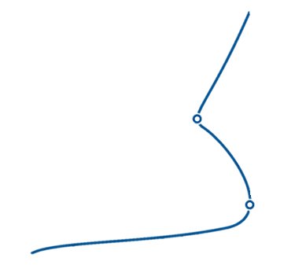
Reg-U-Flo® Optimum
Head
Kick-Flo®
Flush FloTM
Flow

